Slide 1
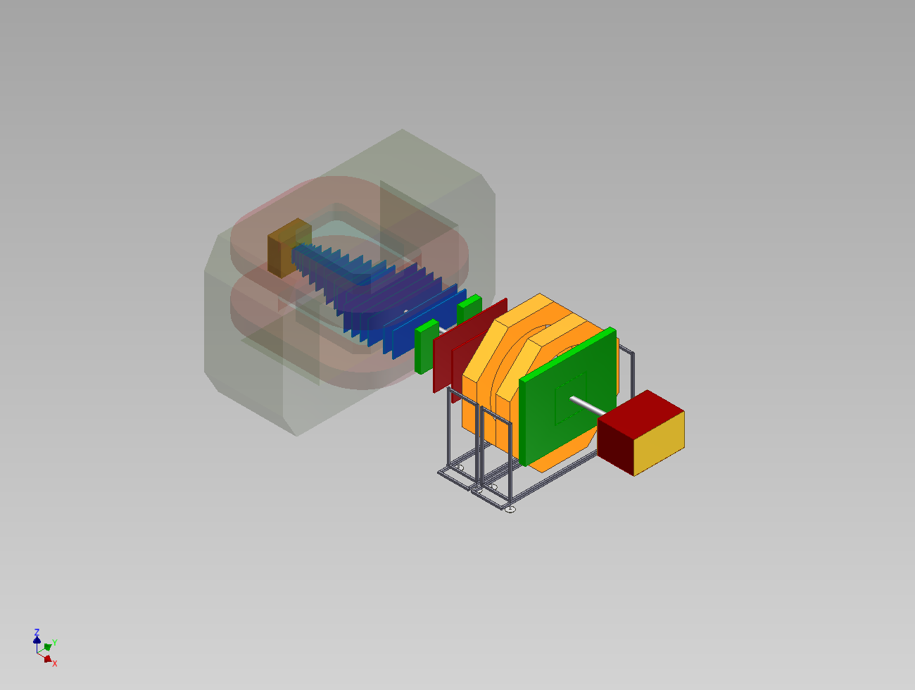
BM@N experiment for studies of Baryonic Matter at Nuclotron
JINR (Dubna), IHEP (Protvino), INR RAS (Troitsk), ITEP (Moscow), SINR MSU
WUT (Warsaw), Goethe Uni (Frankfurt), MoU with GSI (Darmstadt)
M.Kapishin
M.Kapishin SC JINR, 25 September 2014

Slide 2
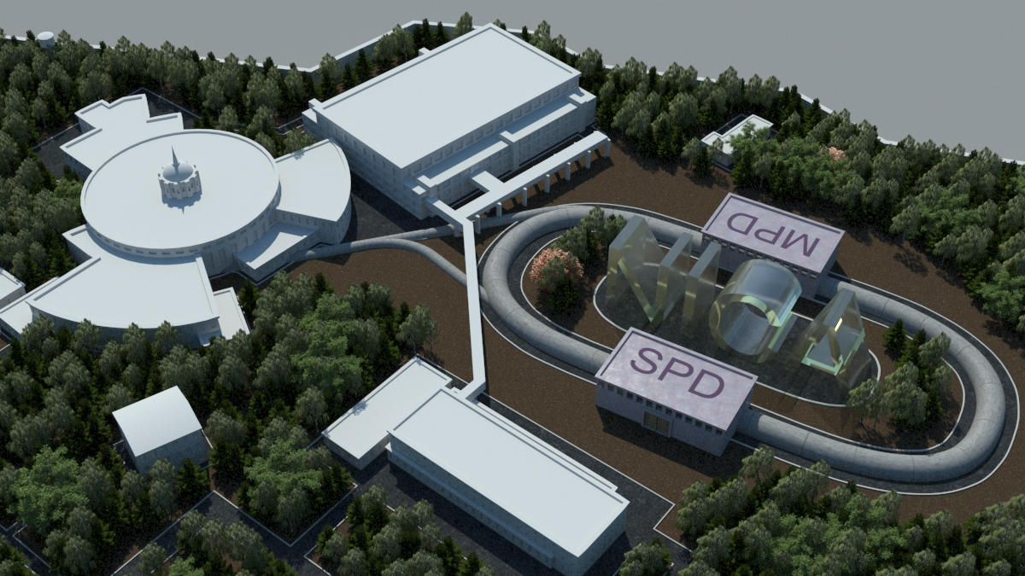



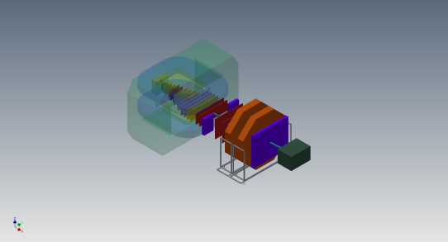





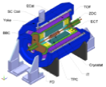
Complex NICA
Parameters of Nuclotron for BM@N experiment:
E_{beam} = 1-6 GeV/u; beams: from p to Au; Intensity~10⁷ c⁻¹ (Au)
Parameters of Nuclotron for BM@N experiment:
E_{beam} = 1-6 GeV/u; beams: from p to Au; Intensity~10⁷ c⁻¹ (Au)
PS and
LU-20 (5MeV/u)
Experiments
with fixed targets
bld. 205
KRION-6T+HILac (3MeV/u)
Accelerator complex LHEP
KRION-6T+HILac (3MeV/u)
BM@N
existing
BM@N
In preparation
bld.#1
Booster
(600 MeV/u)
Booster
(600 MeV/u)
Collider NICA
(1-4.5 GeV/u, C=503 m)
Collider NICA
(1-4.5 GeV/u, C=503 m)
NUCLOTRON 0.6-6 GeV/u
√s=4-11 GeV, C=503 m
MultiPurpose
Detector - MPD
MultiPurpose
Detector - MPD
N
2
M.Kapishin BM@N experiment

Slide 3
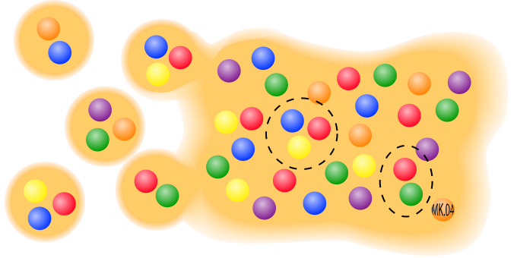
Heavy Ion Collision experiments
Low Intermediate High Ultra-High E_{beam} [A GeV]
Nuclotron (BM@N)
SIS FAIR NICA SPS RHIC LHC
‚Mixed‘ phase:
hadrons (baryons, mesons) + quarks and gluons
||
In-medium effects
Chiral symmetry restoration
Phase transition to sQGP
Critical point in the QCD phase diagram
Baryonic matter
||
Meson and baryon spectroscopy
In-medium effects
EoS
QGP: quarks and gluons
||
Properties of sQGP
M.Kapishin BM@N experiment

Slide 4
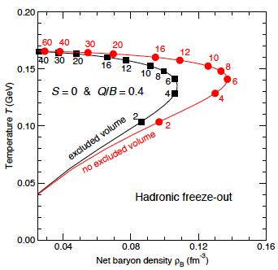
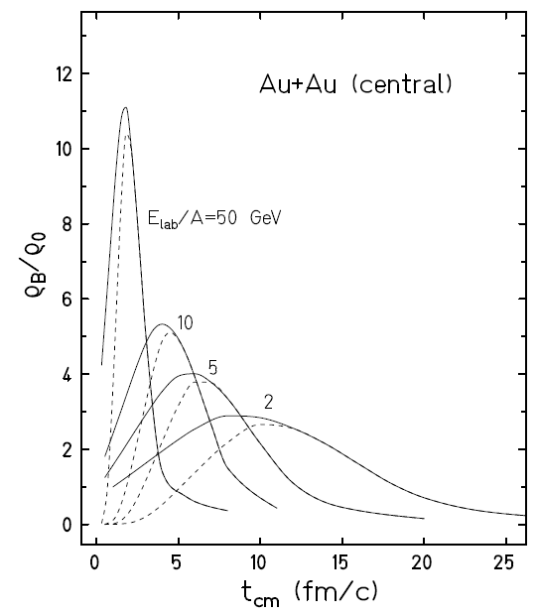
Explore high density baryonic matter
Nuclotron is well suited to study in high density (dominantly baryonic) matter
Baryon-dominated system throughout
Comparatively long lifetime
NICA
BM@N
FAIR SIS-100
BM@N
M.Kapishin BM@N experiment

Slide 5
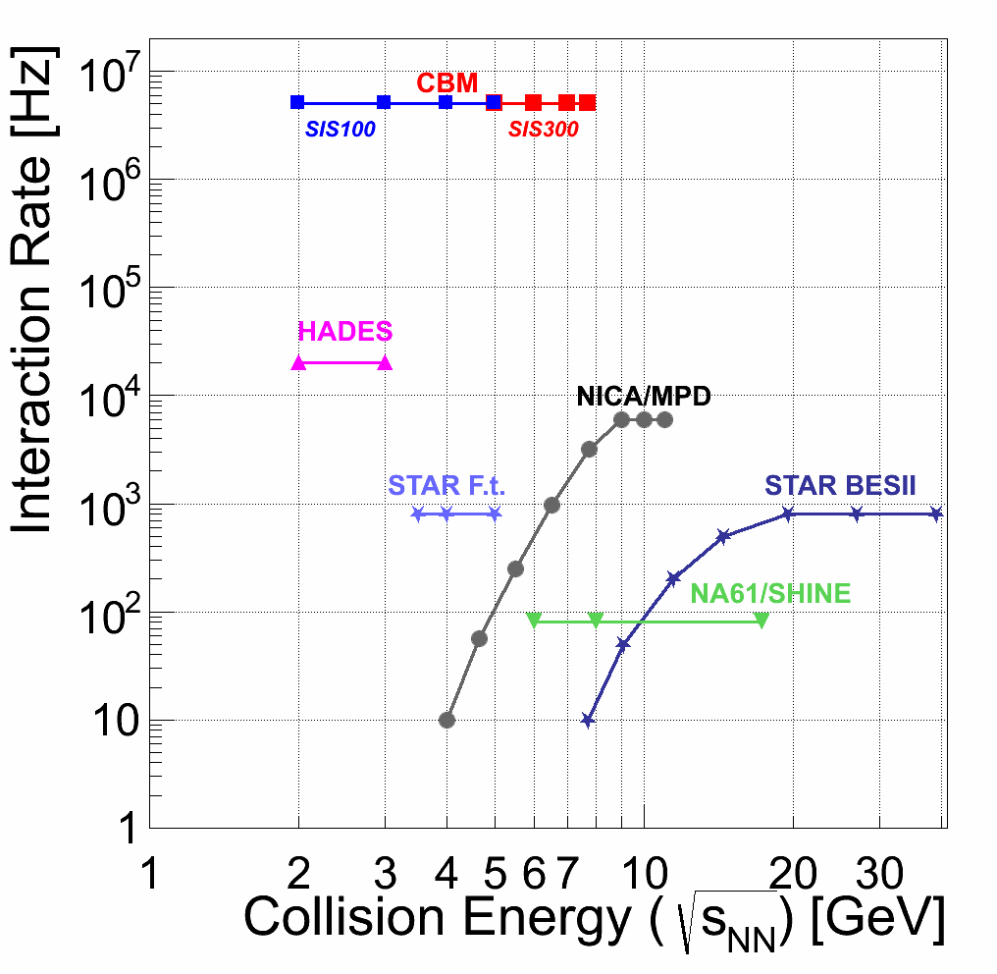
Heavy Ion Collision experiments
BM@N: √s_{NN}=2.3 - 3.5 GeV
BM@N II
HADES
M.Kapishin BM@N experiment

Slide 6
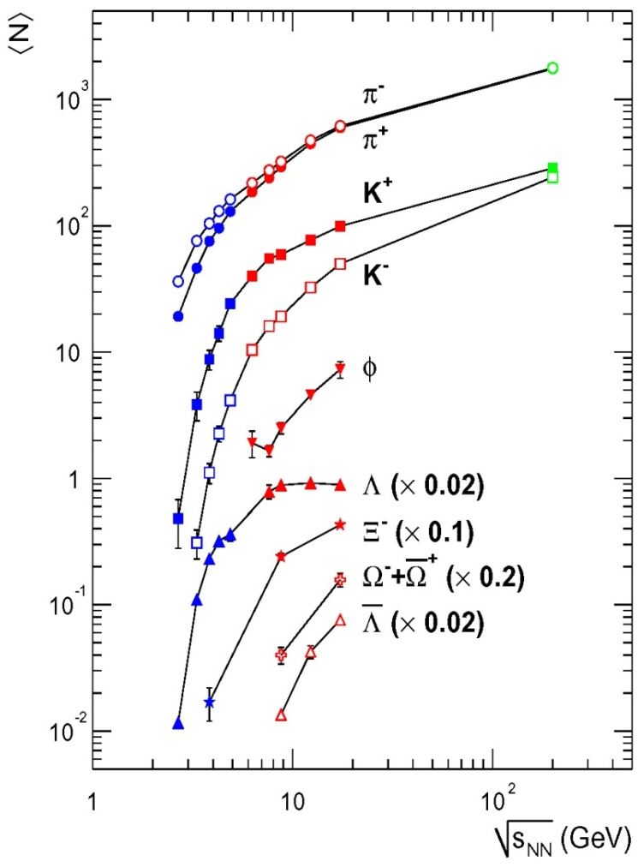
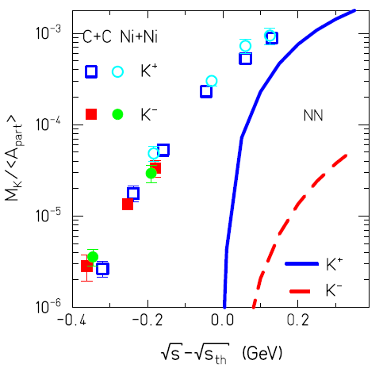
Physics possibilities at the Nuclotron
I. In A+A collisions at Nuclotron energies:
Opening thresholds for strange and multi-strange hyperon production
➔ strangeness at threshold
AGS
NA49
BRAHMS
Au+Au/Pb+Pb, central
➔ Need more precise data for strange mesons and hyperons, multi- variable distributions, unexplored energy range
II. In p+p, p+n, p+A collisions:
hadron production in elementary reactions and ‚cold‘ nuclear matter as ‚reference‘ to pin down nuclear effects
Nuclotron energies
M.Kapishin BM@N experiment

Slide 7
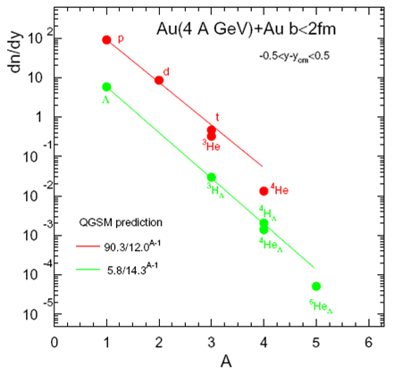
Heavy-ions A+A: Hypernuclei production
In heavy-ion reactions: production of hypernuclei through coalescence of Λ with light fragments enhanced at high baryon densities
Maximal yield predicted for √s=4-5A GeV (stat. model) (interplay of Λ and light nuclei excitation function)
➔BM@N energy range is suited for the search of hypernuclei
M.Kapishin BM@N experiment

Slide 8
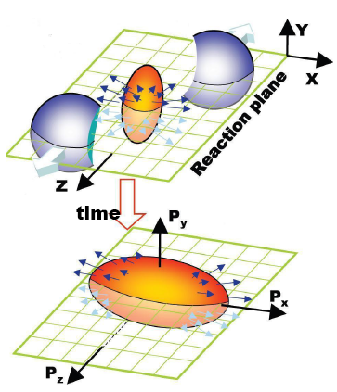
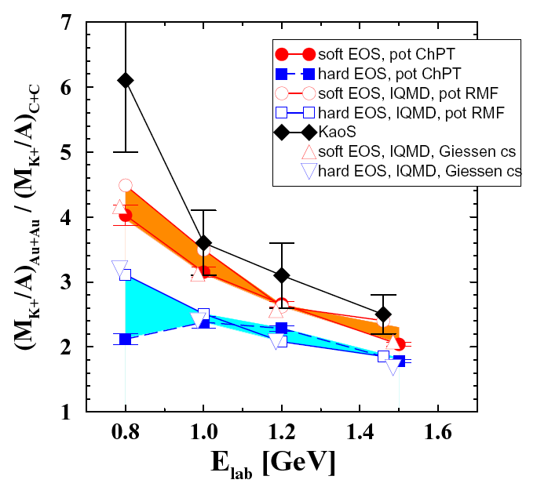
Heavy-ions A+A: Study of the EoS with strangeness
The nuclear dynamics is defined by the EoS (via density dependent NN-interaction)
Observables sensitive to EoS: collective flow (v₁,v₂,…) particle ratios
Direct information – proton v₁,v₂ Alternative information – via strangeness
Experience from SIS and AGS : ratio of K⁺ yield Au+Au/C+C at SIS energies and proton v₁,v₂ favor a soft EoS (somewhat sensitive to the details of models)
⎝ Density dependence of the EoS can be studied in BM@N by a beam energy scan
RQMD
M.Kapishin BM@N experiment

Slide 9
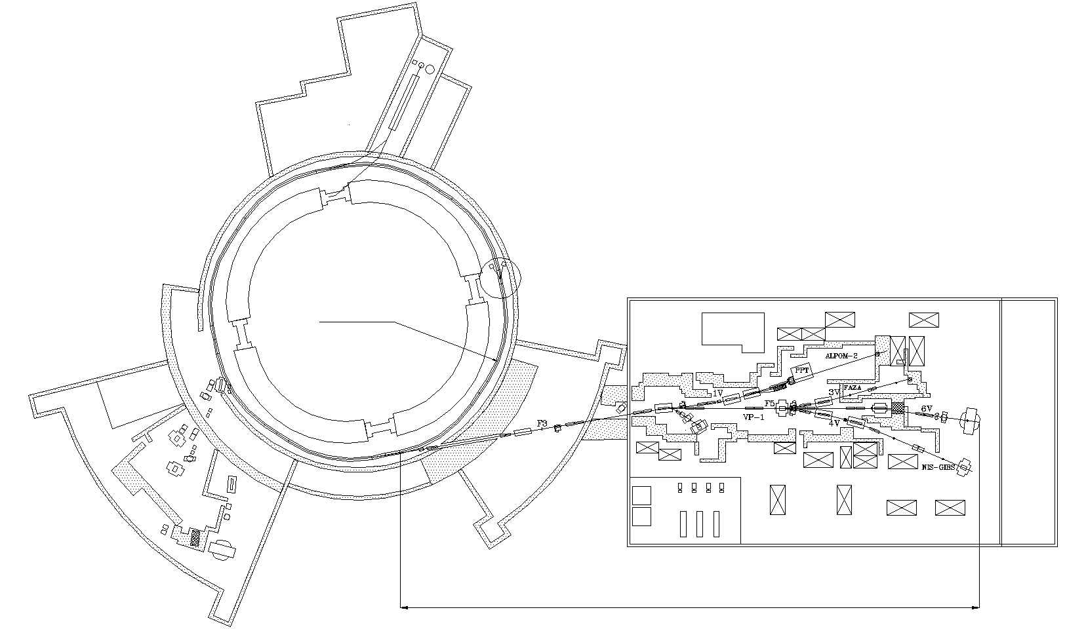
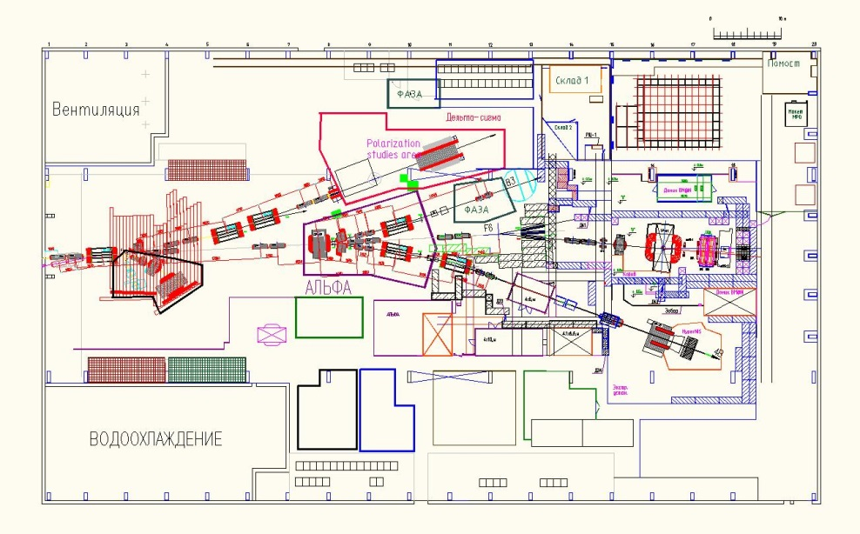
Nuclotron and BM@N beam line
26 elements of magnetic optics:
→ 8 dipole magnets
→ 18 quadruple lenses
Requirements for Au beam:
Minimum dead material
→ need to replace 40 m air intervals / foils with vacuum
Nuclotron
BM@N
~160 m
Building 205
M.Kapishin BM@N experiment

Slide 10

BM@N setup
BM@N setup
BM@N setup
Target & T0 detector
GEM
GEM
DCH
mRPC-2
CPC
DCH
Central tracker (GEM+Si) inside analyzing magnet to reconstruct AA interactions
Outer tracker (DCH, CPC) behind magnet to link central tracks to ToF detectors
ToF system based on mRPC and T0 detectors to identify hadrons and light nucleus
ZDC calorimeter to measure centrality of AA collisions and form trigger
Detectors to form T0, L1 centrality trigger and beam monitors
Electromagnetic calorimeter for γ,e+e-
2 m
mRPC-2
Analyzing magnet
mRPC-1
ZDC
BM@N advantage: large aperture magnet (~1 m gap between poles)
→ fill aperture with coordinate detectors which sustain high multiplicities of particles
→ divide detectors for particle identification to “near to magnet” and “far from magnet” to measure particles with low as well as high momentum (p > 1-2 GeV/c)
→ fill distance between magnet and “far” detectors with coordinate detectors
M.Kapishin BM@N experiment

Slide 11
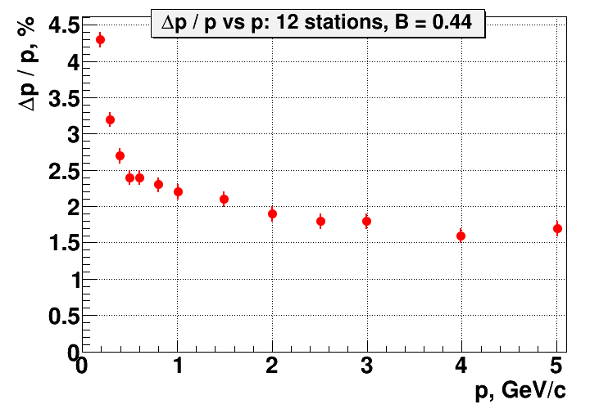
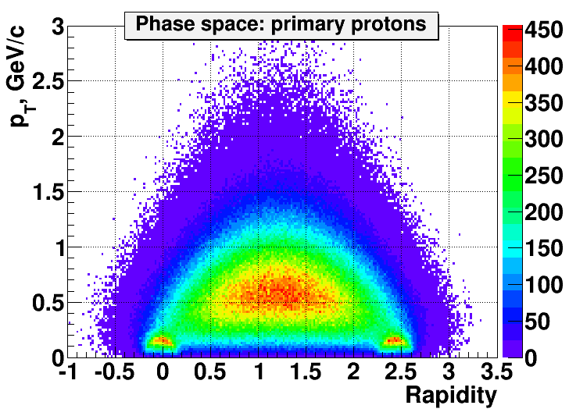
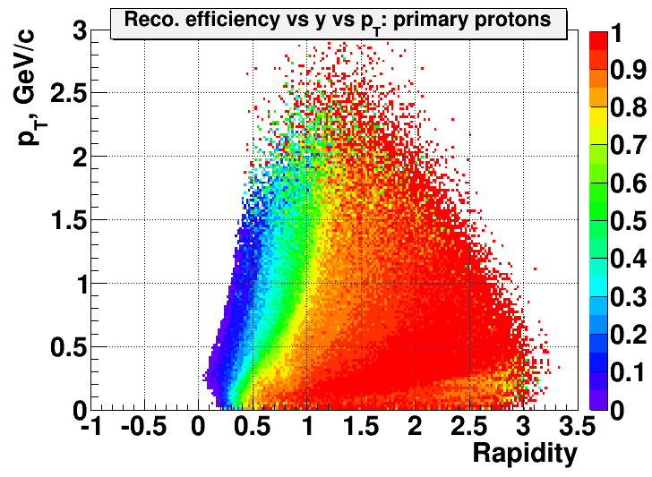
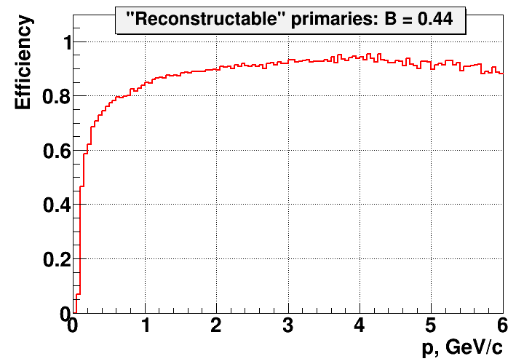
GEM tracker: acceptance / momentum resolution / detection efficiency
Phase space / acceptance to primary protons:
Momentum resolution / detection efficiency
Au+Au, 4.5 AGeV
BMN simulation group
M.Kapishin BM@N experiment

Slide 12
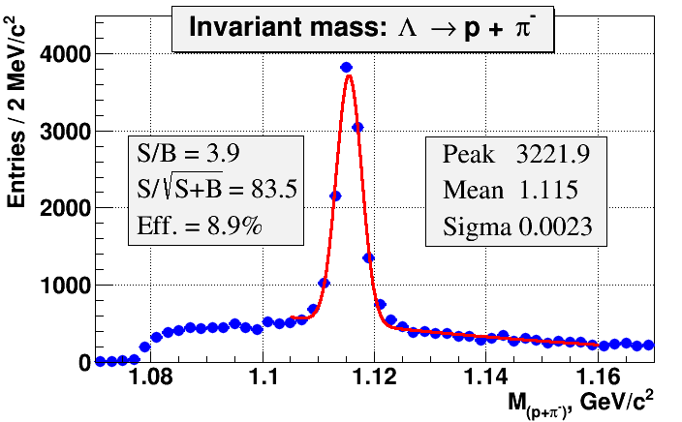
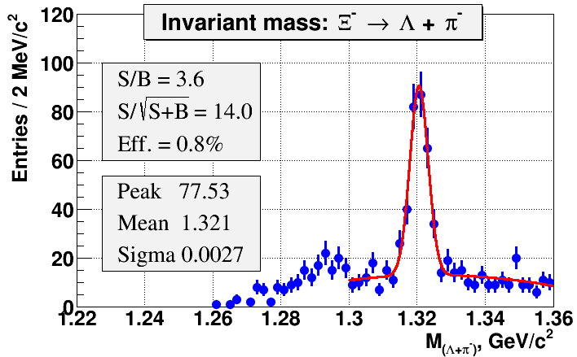
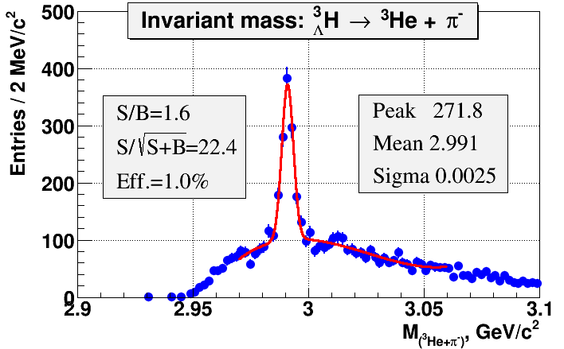
GEM tracker: Λ⁰, Ξ⁻ , ³H_{Λ} reconstruction
Au+Au, URQMD,10k central events
Au+Au, 4.5 AGeV, 900k central events
Λ⁰→pπ⁻
Ξ⁻
Au+Au, 4.5 AGeV, 2.6M central events
Ξ⁻→π⁻+Λ⁰→pπ⁻
³H_{Λ} → ³He π⁻
M.Kapishin BM@N experiment

Slide 13
BM@N in technical runs with deuteron and carbon beams
ECAL
GEM
Deuteron beam, T₀= 4.0, 4.6 GeV/n
MWPC
ZDC
T₀T
X
BM
Z
Analyzing magnet SP-41
Carbon beam, T₀= 3.5, 4.0, 4.5 GeV/n
DCH-1,2
Si plane
ToF-400,700
• Focus on tests and commissioning of central tracker inside analyzing magnet → GEM detectors and forward Si detector for tracking
Test / calibrate ToF, trigger detectors, calorimeters
Program:
Trace beam through detectors, align detectors, measure beam momentum in mag. field of 0.3 – 0.85 T
Measure inelastic reactions d (C) + target → X with deuteron and carbon beam energies of 3.5 - 4.6 GeV/n on targets CH₂, C, Al, Cu, Pb
M.Kapishin BM@N experiment

Slide 14
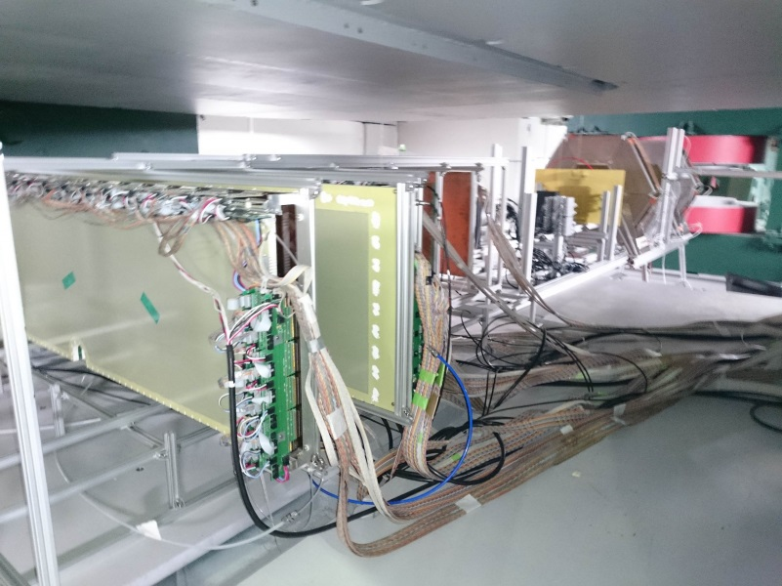
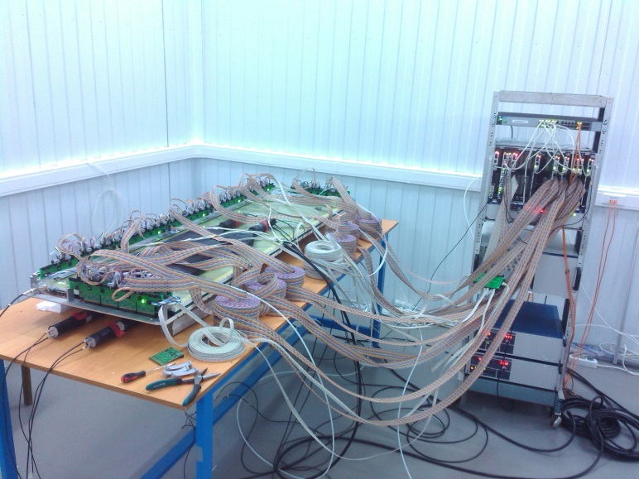
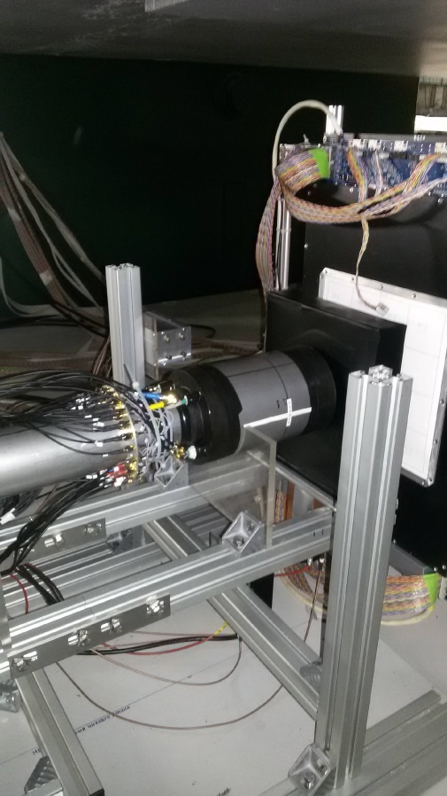
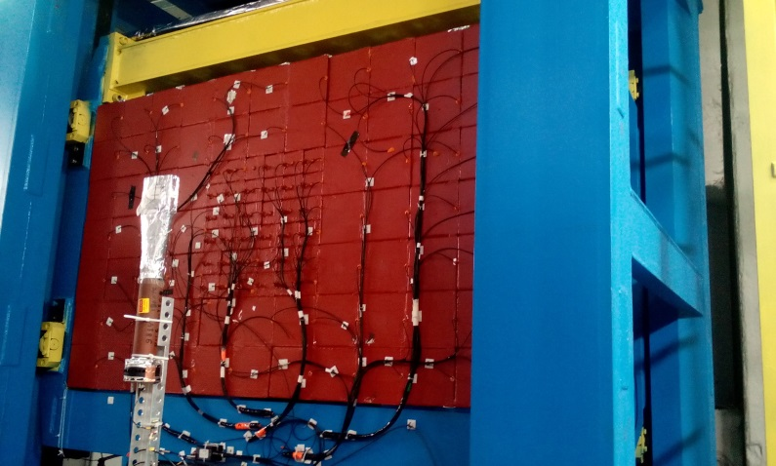
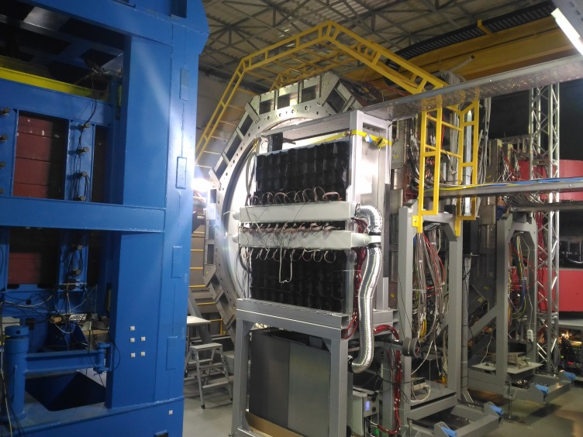
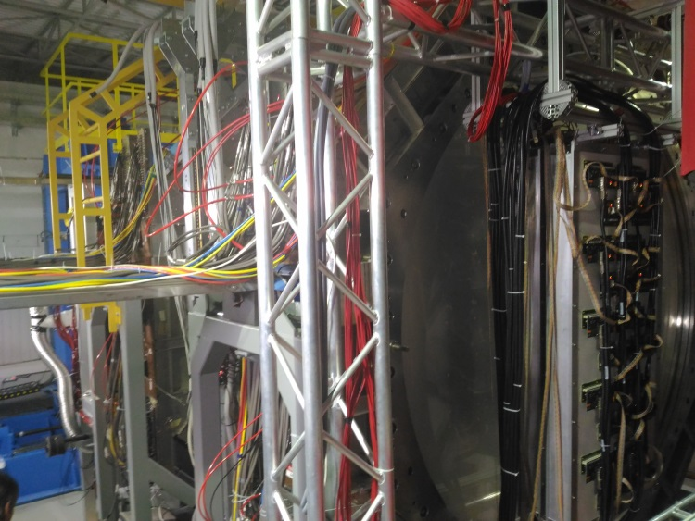
BM@N experiment in carbon run, March 2017
Si detector
2 big GEMs
tests of Big GEM
barrel detector
New detector components: 2 big GEMs, trigger barrel detector, Si detector, ECAL
ZDC
DCH-1
ECAL
ToF-400
M.Kapishin BM@N experiment

Slide 15
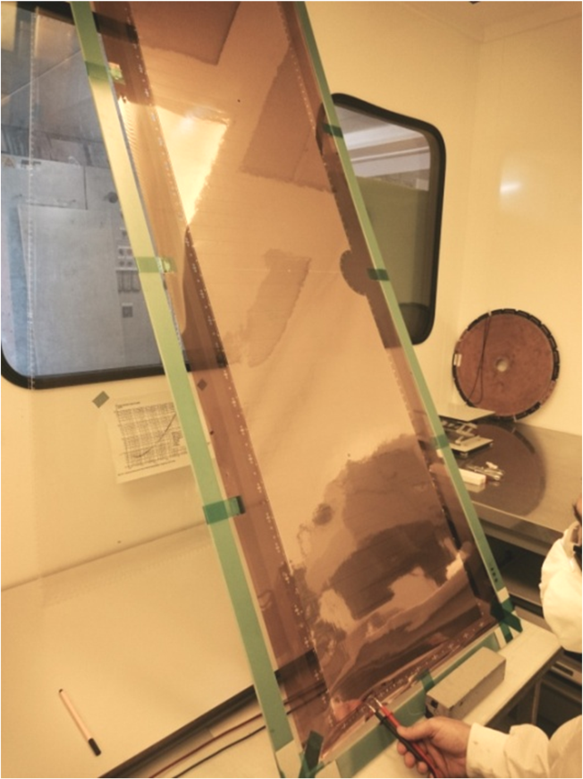
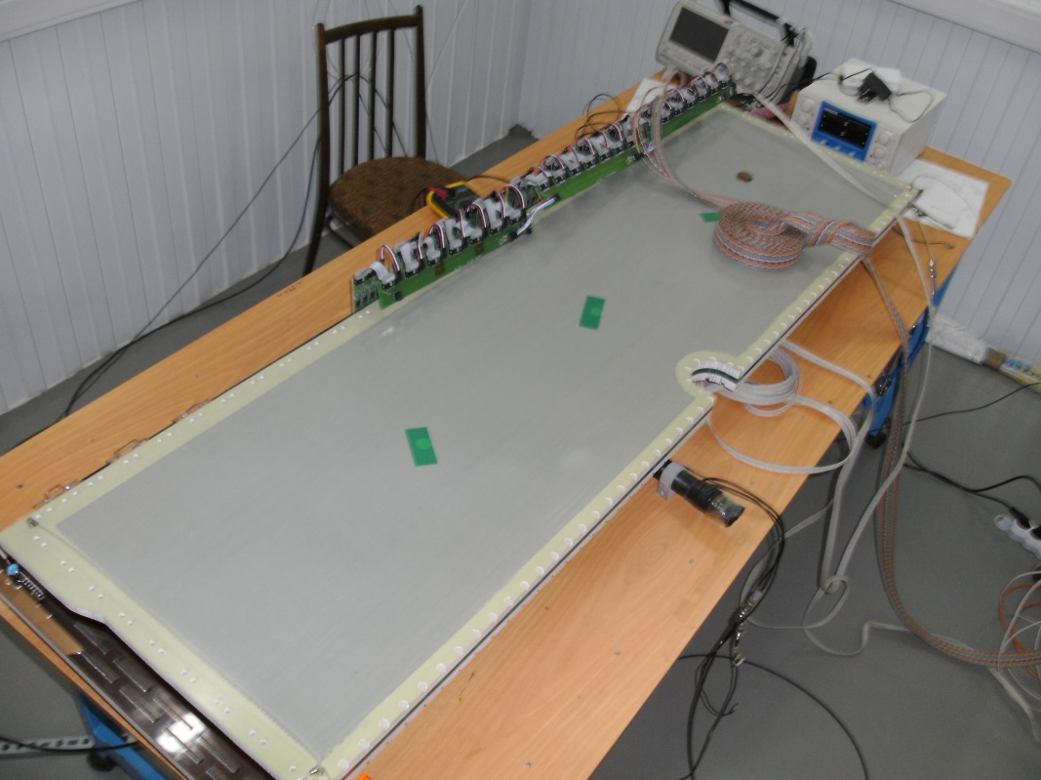
GEM detectors for central BM@N tracker
Tests of GEM detector 163 x 45 cm²
for tracking in technical runs with deuteron and carbon beams in December 2016 and March 2017 used 5 detectors 66 x 41 cm² and 2 detectors 163 x 45 cm²
for BM@N run in autumn 2017 plan to produce more detectors 163 x 45 cm²
M.Kapishin BM@N experiment

Slide 16
Results of Λ reconstruction with GEM detectors in deuteron beam interactions
d + target → Λ + X
Soft selection
Tight selection
Λ→pπ-
~1900 Λ, sigma ~3.8 MeV
Need to improve vertex reconstruction → forward Silicon detector already implemented
Need more GEM planes to improve track momentum reconstruction → plan to install more GEM planes in autumn 2017
M.Kapishin BM@N experiment

Slide 17
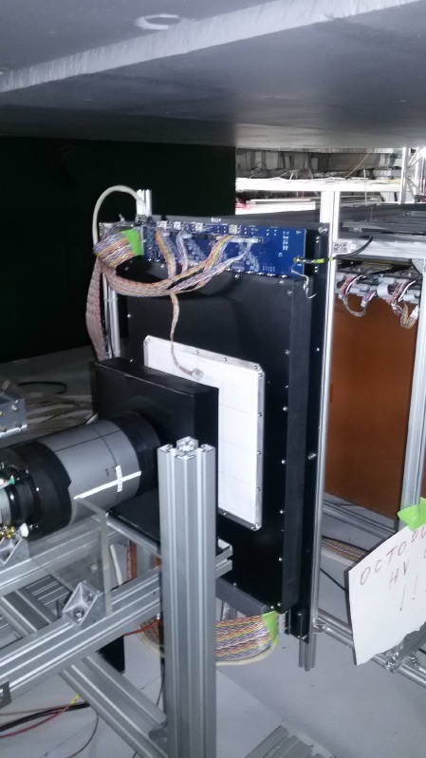
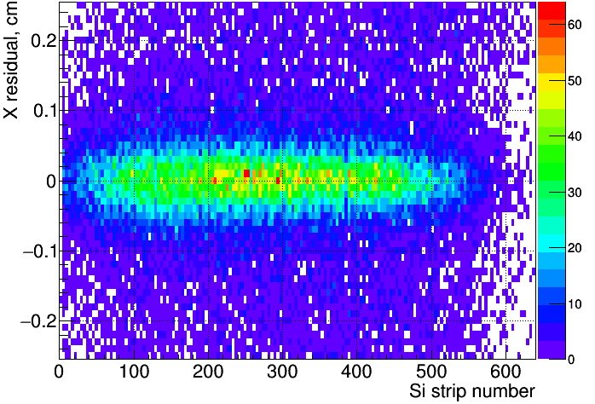
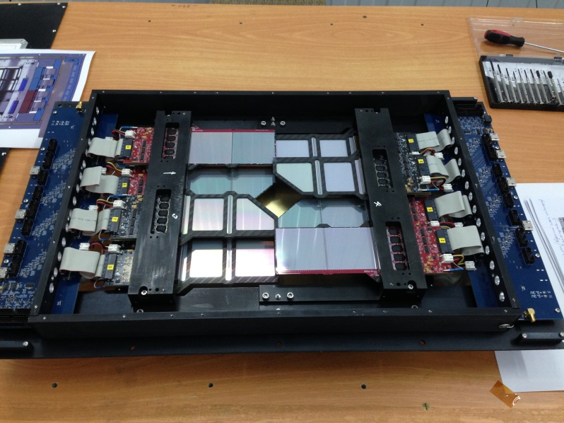
Forward silicon strip detector
Si-GEM residuals (cm) vs Si strip number
2-coordinate Si detector X-X’(±2.5º) with strip pitch of 95/103 μm, full size of 25 x 25 cm² , 10240 strips
Detector combined from 4 sub-detectors arranged around beam, each sub-detector consists of 4 Si modules of 6.3 x 6.3 cm²
One plane installed in front of GEM tracker and operated in March 2017
M.Kapishin BM@N experiment

Slide 18
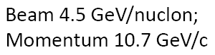
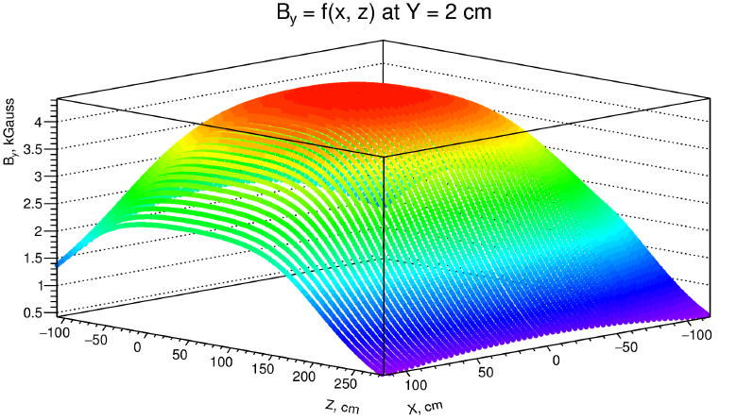
Beam Momentum measured with DCH outer tracker
Simulated event C+C
Errors → momentum resolution
M.Kapishin BM@N experiment
Magnetic field

Slide 19
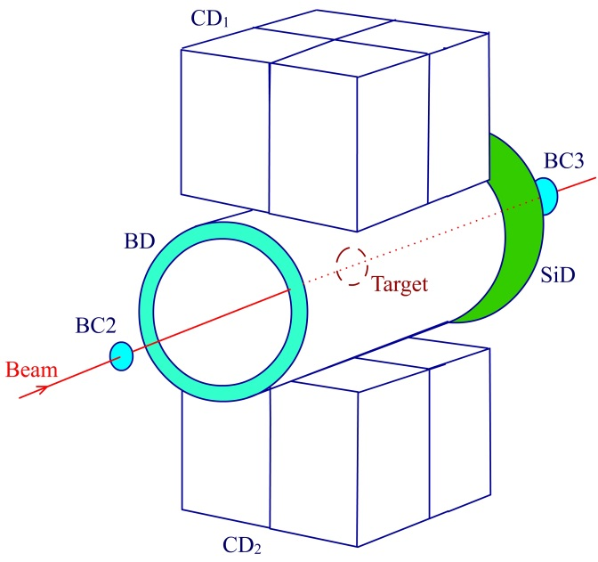
Trigger detectors: beam counters and barrel detector in carbon run (March 2017)
FD
Trigger and T0 detectors for heavy ions
Selection of events with activity in barrel detector: BD >= 2, >= 3
M.Kapishin BM@N experiment

Slide 20
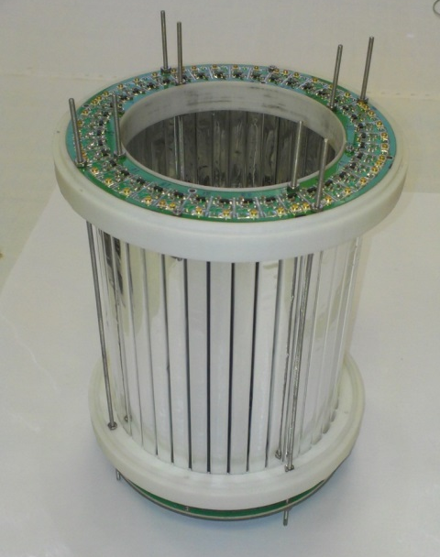
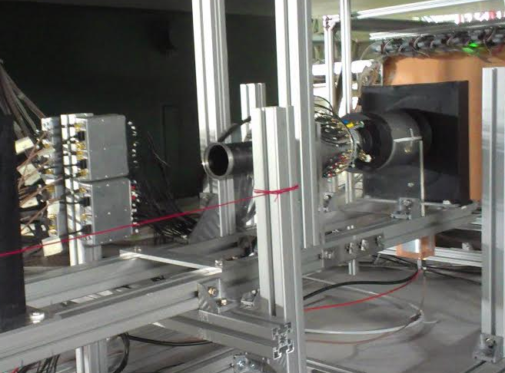
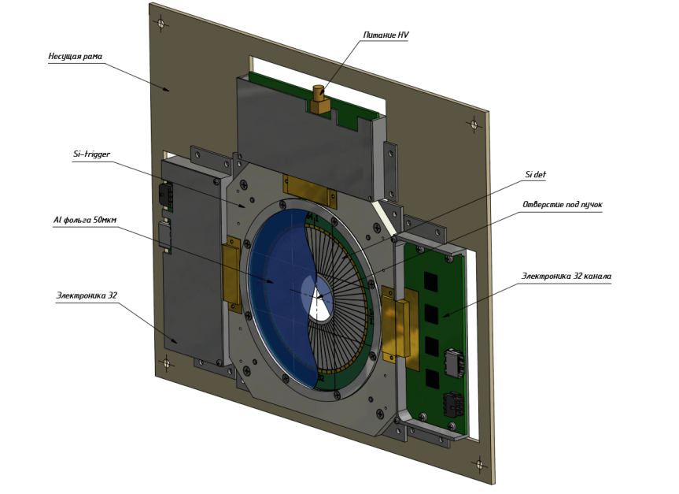
Trigger barrel and Si detectors in BM@N setup
Trigger group
barrel detector
FD
Barrel Detector multiplicity in carbon beam interactions with different targets
Forward Si trigger detector development
C + C, BD≥2
C + Al, BD≥3
C + Cu, BD≥3
C + Pb, BD≥3
M.Kapishin BM@N experiment

Slide 21
, Ar
0.5M 0.5M 0.5M
5k 5k 5k 10k 20k→50k
6
8
+
techn.
M.Kapishin BM@N experiment

Slide 22
Concluding remarks and next plans
BM@N scientific program comprises studies of nuclear matter in intermediate range between SIS and NICA/FAIR
BM@N experiment is in a stage of putting into operation
BM@N technical runs performed with deuteron and carbon beams at energies: T0 = 3.5 - 4.6 AGeV
Data collected to check efficiencies of sub-detectors and develop algorithms for event reconstruction and analysis
Major sub-systems are operational, but are still in limited configurations
BM@N plans for next run in late autumn 2017:
Beams provided by heavy ion source: Ar, Kr, extracted to BM@N setup
Extended configuration of BM@N setup
BM@N future plans for Au+Au: collaborate with CBM to produce and install large aperture STS silicon detectors in front of GEM setup
M.Kapishin BM@N experiment

Slide 23
Short /intermediate Range Correlations in nuclei
Short Range Correlations in nuclei
SRC ~R_{N} LRC ~R_{A}
~1 fm
≤1.f
1.7f
1.7 fm
Nucleons
2N SRC: A pair with large relative momentum between nucleons and small CM momentum
High – Momentum Component of Nuclear Wave Function
Strong Short-Range Force between Nucleons.
tensor force, repulsive core, 3N forces
Notes:
23
23

Slide 24




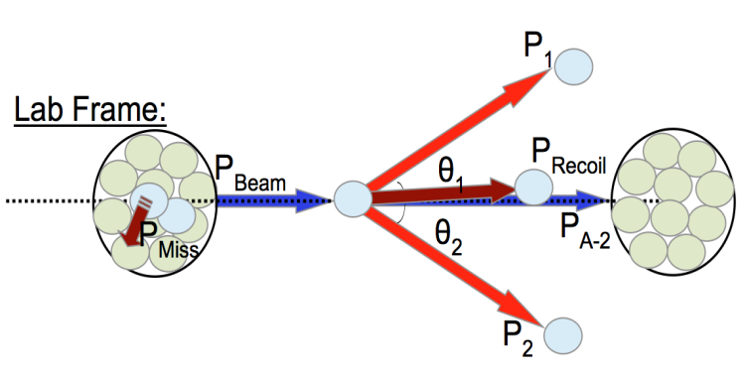
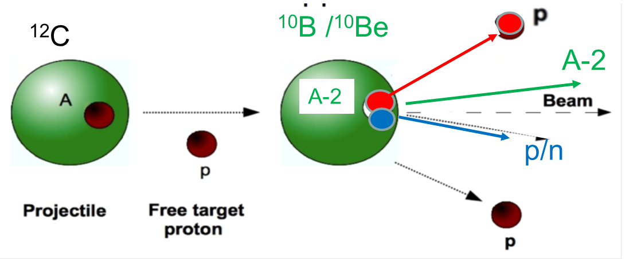
:
A proposal for BM@N experiment
to study SRC with hard inverse kinematic reactions
¹²C Beam Frame
JINR (Dubna): BM@N
Israel: Tel Aviv University
Germany: TUD and GSI
USA: FIU, MIT, ODU, PSU
FRANCE: CEA
Objectives:
• identify 2N-SRC events with inverse kinematics
• study isospin decomposition of 2N-SRC
• study A-2 spectator nuclear system
Lab frame

Slide 25

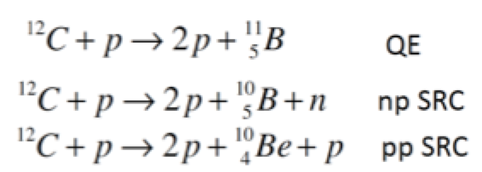
SRC @ BMN
Carbon beam with momentum of 4 GeV/c per N
31.5° ± 6.5°
proton
beam
Neutron / proton recoil
A-2
proton
Get the ratios:
31.5° ± 6.5°
2N-SRC dominance
np-dominance
Fraction of FS with A-2
25

Slide 26
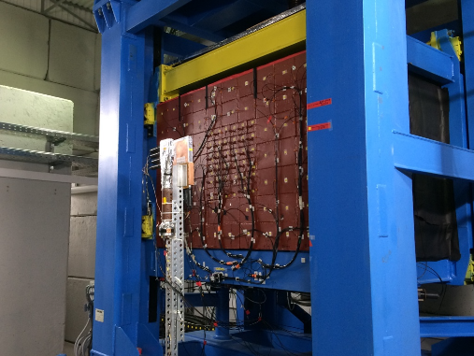
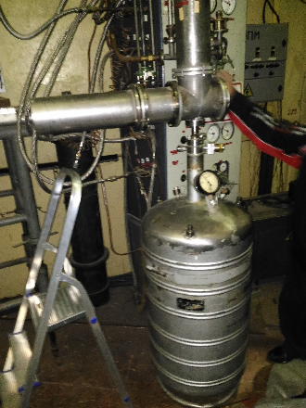
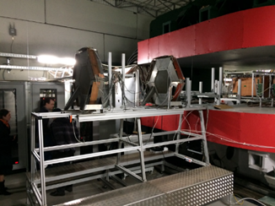
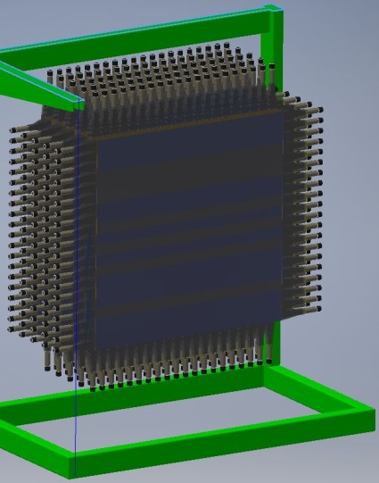
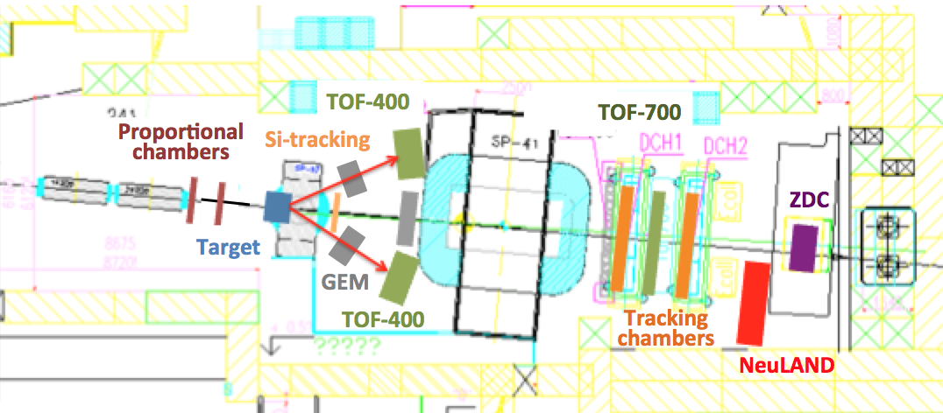
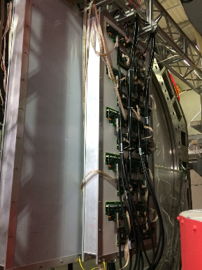
Experimental set up
Target
ZDC
LAND
26
LAND
TOF-400
Notes:
26

Slide 27
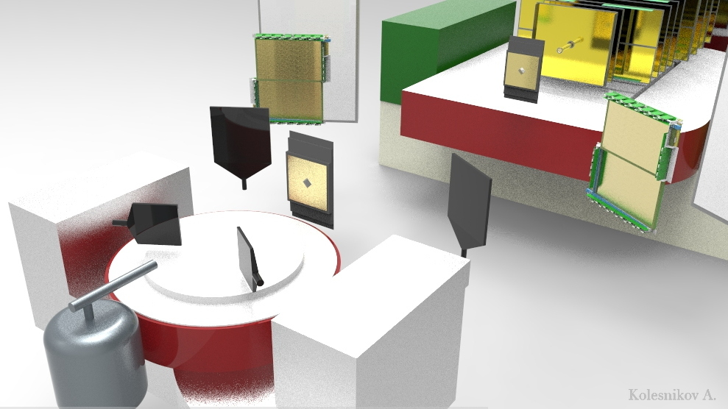
Expected SRC event rate
Cuts
|θ_{1,2}-31.5º|<6.5º
|Δφ_{1,2}|<7.5º
|s,t,u|>2 (GeV/c)²
P_{miss} >0.275 GeV/c
GEM + ToF
Si
LS1
Si
GEM + ToF
LS2
Trigger:
T0 ∙ T1 ∙ LS1 ∙ LS2
T0 +Target + T1
Events
4000
Signal rates for 14 days of data taking
Within LAND acceptance
200
350
100
→ First SRC @ BMN run in December 2017

Slide 28

Future Perspectives SRC@ BMN
Ion-Beam:
SRC studies in nuclei far from stability
Comparisons with proton and electron data
Physics highlights:
Spectroscopy of residual “A-2” system
SRC pair quantum numbers, pairing mechanisms
Proton Beam:
Main Advantage: Higher-Statistics
Physics highlights:
Repulsive core of NN Interaction,
A-dependence of SRC in different (asymmetric) nuclei
Polarized Deuteron Beam:
Determination of high-momentum d-wave component of deuteron wave function

Slide 29
Thank you
for attention!
M.Kapishin BM@N experiment

Slide 30
Backup slides
M.Kapishin BM@N experiment

Slide 31

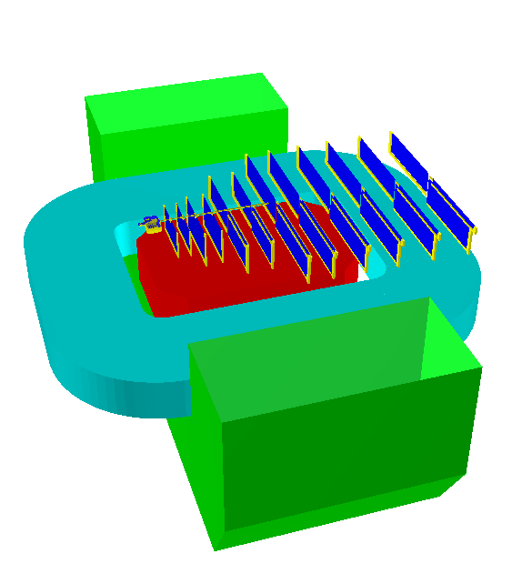

Optimized GEM detector configuration
BMN simulation group
Stations 1 - 4
12 stations: Z = 30 – 45 – 60 – 80 – 100 – 130 – 160 – 190 – 230 – 270 – 315 – 360
Stereo angles: 0 – 7.5 deg in stat. 1-4; 0 – 15 deg in stat. 5 - 12
Pitch: 400 um in stat. 1-4, 800 um in stat. 5-12
14-oct-2014
M.Kapishin BM@N experiment

Slide 32

GEM detector efficiency in deuteron run
Plane efficiency calculated using reconstructed tracks of beam inclined at different angles
X plane
X‘ plane
X & X‘ planes
M.Kapishin BM@N experiment

Slide 33
Momentum resolution from Λ mass resolution
MC: p, π⁻ momentum resolution for experimental Λ→pπ- resolution
M.Kapishin BM@N experiment

Slide 34


ToF-400 and ToF-700 based on mRPC
ToF-700 wall
ToF-400 wall
BM@N beam axis
M.Kapishin BM@N experiment

Slide 35



Questions from HADES experiment
Excess of φ and Ξ⁻ production in heavy ion collisions
M.Kapishin BM@N experiment

Slide 36

Excess strength in np momentum distribution due to strong correlations induced by tensor NN potential
pn
¹²C
pp
n p
SRC
L = 0, 2
Notes:
36

Slide 37

np / pp SRC pairs ratio
c
Al
Fe
Pb
O. Hen et al., Science 346, 614 (2014).

Slide 38



Background Rates
QGSM generator
ππ | 35%
πp | 60%
pp | 5%
P_{miss} (GeV/c) | SRC signal | Mean Field
0.250 | 6347 | 826
0.275 | 4693 | 341
0.300 | 3022 | 132
0.325 | 1770 | 48
0.350 | 1255 | 19
0.375 | 824 | 8
Reaction | Signal / Background
p(¹²C,2p)N | 4:1
p(¹²C,2p,n)N | 18:1
p(¹²C,2p,A-2)N | 20:1

